Slide 1


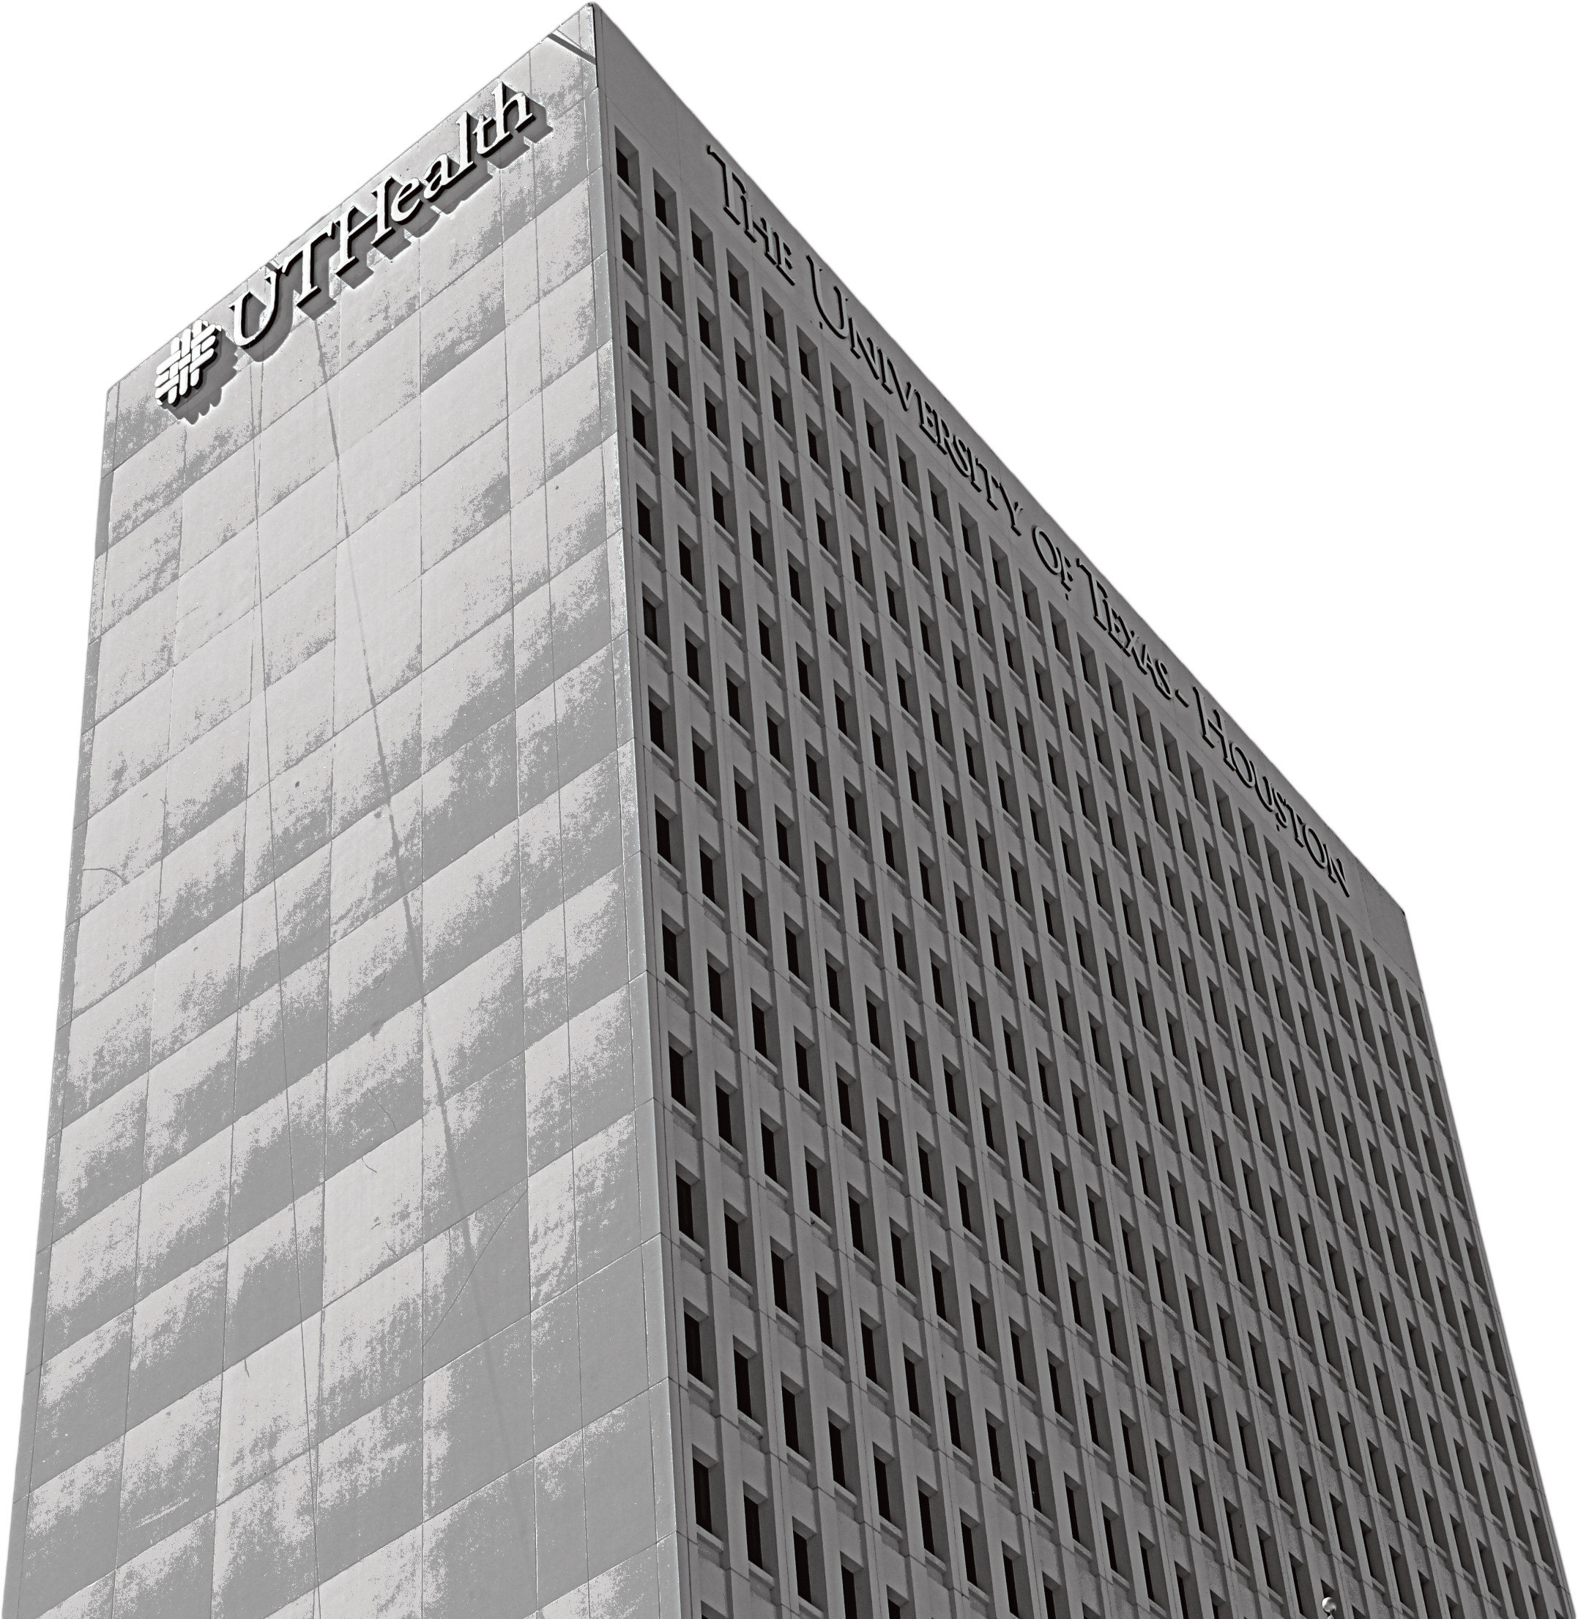

Title of Your Poster Goes Here
Group Name
Members of your group
Introduction
One Column Header
This is a point font, suitable for medium-size presentations. Consider presentation when formatting. Presentations to be given on stage will require less information and larger fonts, whereas posters dis
played in an environment where the viewer will be able to stand directly in front of it can be more detailed and use smaller fonts to maximize content.
You are encouraged to copy and paste this section header and text box as many times as needed, resizing to fit your columns and content.
2 Column Header
You are encouraged to copy and paste this section header and text box as many times as needed, resizing to fit your columns and content.
Tables and Charts
Table 1: Table Header
Column 1 | Column 2 | Column 3
Data 1-1 | Data 1-2 | Data 1-3
Data 2-1 | Data 2-2 | Data 2-3
Data 3-1 | Data 3-2 | Data 3-3
Data 4-1 | Data 4-2 | Data 4-3
Data 5-1 | Data 5-2 | Data 5-3
Data 6-1 | Data 6-2 | Data 6-3
Data 7-1 | Data 7-2 | Data 7-3
Table / Chart formatting is only an example. Always use whatever formatting best organizes your data.
Introduction
One Column Header
This is font, suitable for medium-size presentations. Consider presentation when formatting. Presentations to be given on stage will require less information and larger fonts, whereas posters displayed in an environment where the viewer will be able to stand directly in front of it can be more detailed and use smaller fonts to maximize content.
This is font, suitable for medium-size presentations. Consider presentation when formatting. Presentations to be given on stage will require less information and larger fonts, whereas posters displayed in an environment where the viewer will be able to stand directly in front of it can be more
detailed and use smaller fonts to
maximize content.
Acknowledgements
Support for your project.
Please contact the first
author via email:
_____________@uth.tmc.edu
Texas Medical Center, Houston TX

