Slide 2
Hire me : Resumes, Resources, Tactics and a little advice
Debora Simmons, PhD, RN, CCNS, FAAN
Susan H. Fenton, PhD, RHIA, FAHIMA
The University of Texas Health Science Center at Houston
School of Biomedical Informatics

Slide 3
Things to share today
A Resume today looks like
where to find guidance for building your resume - think a little differently
Networking to get a call for your resume
Things I have seen applicants do that sabotaged their hire

Slide 4
Three Interesting Hiring Statistics
On average:
Every corporate job opening attracts 250 resumes
Only 4 to 6 of those 250 people will be called for an interview
Only 1 of those 250 will be offered a job.
Source: https://www.glassdoor.com/employers/blog/50-hr-recruiting-stats-make-think/ (January 20, 2015 | Glassdoor Team)

Slide 5
85% of critical jobs are filled via networking
https://www.linkedin.com/pulse/new-survey-reveals-85-all-jobs-filled-via-networking-lou-adler/ Published on February 29, 2016

Slide 6
NETWORKING IS THE ANSWER

Slide 7
NETWORKING
leads to needing
a resume !

Slide 8
A resume today looks like
No more than two pages
No more than the last ten years
Skills are prevalent
Challenge, Action, Result statements are prevalent
Change the resume to fit the job
Constantly prepare and improve your resume

Slide 9
Building a resume
Is continuous through out your education and career
Changes with time and the job goal
Is a discipline to keep up with achievements
Requires continuous research every time you want to apply

Slide 10
Top Job Search Sites : look at the differences
Monster.com
Glassdoor.com
Indeed.com

Slide 11
Monster.com
Contact information
Summary
Skills
Professional Experience
Education

Slide 12
Ten Worst Resume Mistakes
Typos and grammatical errors
Not specific
Generic Resumes
Highlight duties not accomplishments
Too long or too short
Bad summary
No action verbs
Visually busy
Leave off important information
10. Incorrect contact information

Slide 13
Indeed.com: Research Resumes to inform yours

Slide 14
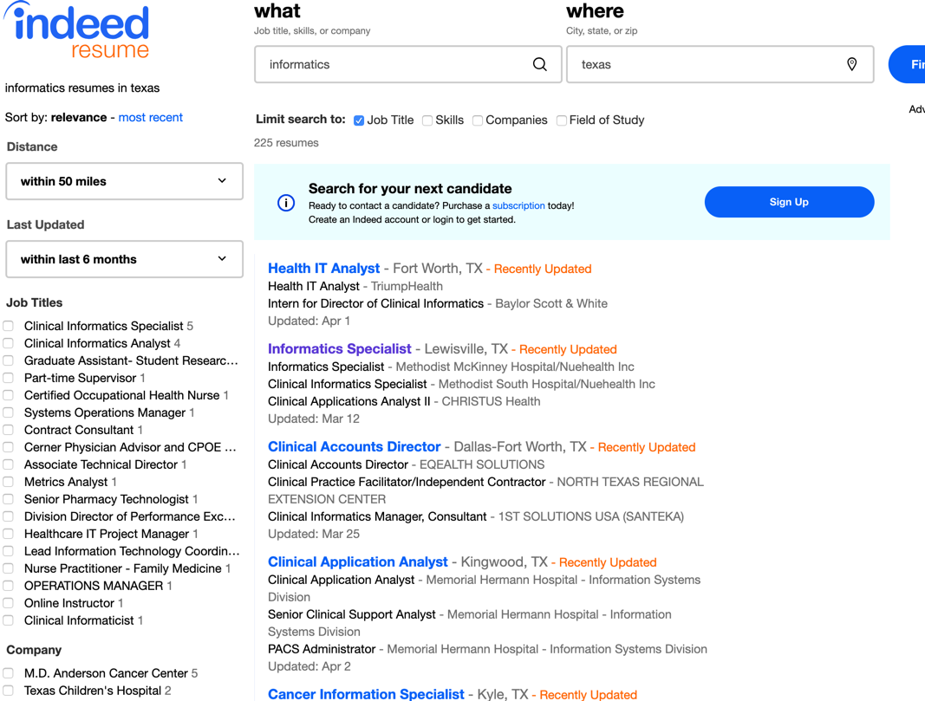
Indeed.com: 225 Resumes within last 6 months
ddddd
ddddd

Slide 15
Glassdoor.com: Interview Questions

Slide 16
Applicant Tracking Systems
Applicant Tracking Systems:
act as a human resources database for organizing applicants
allow sifting through large groups of job applicants, and to organize and contact those applicants
rank applicants by keywords (skills, job positions)
allow filtering by location and education
THEREFORE you should be optimizing your resume specifically to fit the job you are applying for.
Source: https://www.jobscan.co/applicant-tracking-systems

Slide 17
THEREFORE you should be
optimizing
your resume specifically to
fit the job you are applying for.

Slide 18
Resume basics

Slide 19
Start an excel file of your search
Keep a pdf of each resume you send out and to who
Research and make notes of the company
Track who you sent it to
Track any calls from or to
Track- do you mind if I contact you again in a month to see if a you have any openings or suggestions ?

Slide 20
Research and make notes of the company/person specifically
What do they do ? ( LinkedIn?)
Where are they based ?
Short history or highlights
Did someone refer you ?

Slide 21
ONE PAGE RESUME
If they give you directions – follow them
Your name
Your contact information
Your top skills (specifically answering the job posting )
List last ten years

Slide 22
File Name !
1. Include Your Name
2. Keep It Snappy –
Under 24 characters and spaces—plus the .doc extension. Many computers only show the first 24 characters (don’t be silly)
3. Follow the Rules
Letters and numbers are all fine, plus a few standard keyboard symbols (not / or .)
4. Include the Word “Resume”
5. Leave Out the Version Numbers

Slide 23
ONE PAGE RESUME
TOP SIX TEMPLATE SOURCES https://www.thejobnetwork.com/top-6-resume-template-resources/

Slide 24
Google Docs
Lots of templates

Slide 25
Skills ! The reason you get hired
Get feedback from others
Use online skills inventories
Notes:
Do NOT misrepresent what you can do!

Slide 26
Writing Accomplishment Statements to Demonstrate Your Value (per jobscan.com) Source: https://www.jobscan.co/blog/resume-accomplishments-examples/ visited 3/18/2019
High-quality resume accomplishments are quantifiable and measurable. Dollar amounts, timespans, volume, and percentages are all great ways to quantify your accomplishments on a resume.
CAR stands for Challenge, Action, and Result. Every accomplishment should include the problem or challenge, the action you took, and the stellar result of your hard work. You can also invert this formula by leading with the result. Starting a sentence with a dollar figure or percentage will garner more attention.
Make sure your accomplishments are taken seriously by including context when possible. “Saved $100,000” doesn’t mean much on its own. “Saved $100,000 YoY, decreasing operating budget by 52%” is better.
Along with measurable results, resume keywords can make resume accomplishments stand out. Reference the job posting to figure out which keywords the hiring manager will be looking for most.

Slide 27
Writing Resume Accomplishments
What did I achieve that had value -$$$$ and Time
Did I reach my goals quickly? If so, what was the exact time period?
Did I exceed my goals often? If so, to what degree?
Starting a sentence with a dollar figure or percentage will garner more attention.
If you are answering an ad – use the keywords
https://www.jobscan.co/blog/resume-accomplishments-examples/

Slide 28
Lets write CAR statements
Challenge
Action
Result
Every accomplishment should include the problem or challenge, the action you took, and the stellar result of your hard work. You can also invert this formula by leading with the result. Starting a sentence with a dollar figure or percentage will garner more attention

Slide 29
Exercise : Think about one of your positions in the last ten years and write one statement pertinent to informatics
Context:
Action:
Result:

Slide 30
Top Resume

Slide 31
Assignment
Draft your informatics executive resume
Submit on Canvas by due date

Slide 32
Hire me : Resumes
Debora Simmons, PhD, RN, CCNS, FAAN
Susan H. Fenton, PhD, RHIA, FAHIMA
The University of Texas Health Science Center at Houston
School of Biomedical Informatics

