Slide 1
Orientation and Overview
Fall 2013

Slide 2
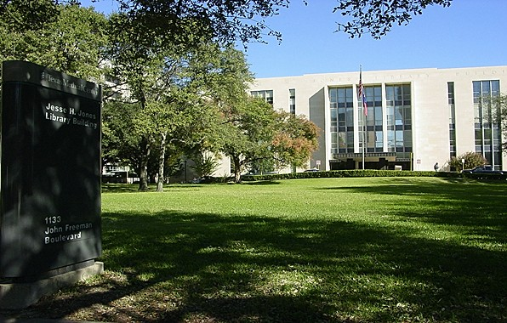
The Texas Medical Center Library
1133 John Freeman, Blvd, Houston 77030
713.795.7200
www.library.tmc.edu

Slide 3
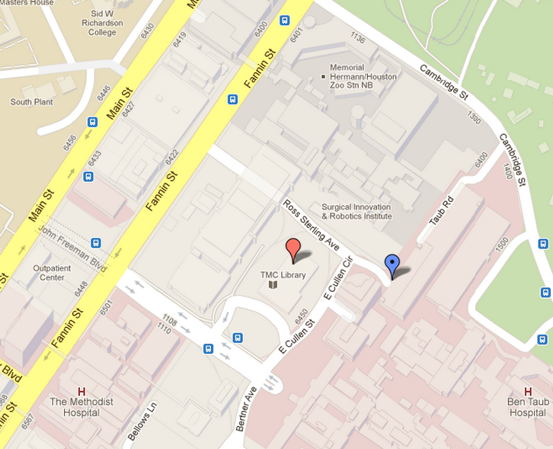
The Texas Medical Center Library
Accessible by car, light-rail or bus
Light-rail stop: “Memorial Herman/Zoo”
Garage 3 (under library) or Garage 4, daily max cost of $12
Limited parking in front of building—20 minute max, strictly enforced
Variety of bus stops throughout the TMC depending on the route
Visit www.texasmedicalcenter.org for additional parking & transportation information

Slide 4
General Information
Website: www.library.tmc.edu
Hours
Monday – Thursday 7:00am – 10:00pm
Friday 7:00am – 9:00pm
Saturday 9:00am – 5:00pm
Sunday 1:00pm – 8:00pm
Phone Numbers
Circulation/Account Info: 713.799.7147
Reference/Research Help: 713.799.7161

Slide 5
Library Services
Online Resource Access
Collections & Databases
Circulation Services
Reference Services
Interlibrary Loan (ILL) Services
The Historical Research Center / McGovern Collection
Study Rooms
Computer Labs
Computers, Scanners, Copiers

Slide 6
Resource Access
Resource Access allows registered users to access The TMCL’s electronic journals, books and databases from inside and outside the library building.
All library users are required to login with Resource Access usernames and passwords.
Registration usually takes just a few minutes!
You must use your institutional email address to create your account
Each time you visit the TMCL website to use an electronic resource you will need to sign in. As long as you keep the browser open, you will remain signed in.

Slide 7
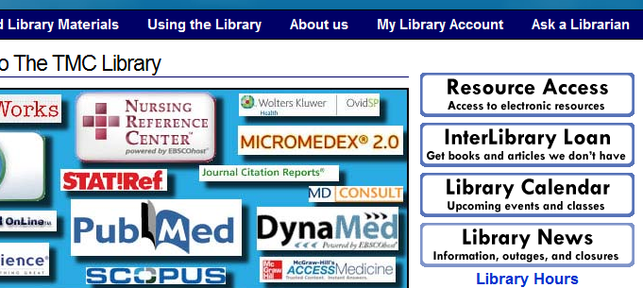
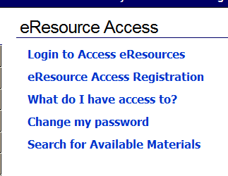
Resource Access: Signing-Up
www.library.tmc.edu
Upper right corner “Resource Access” (click link)
On the next page, select
“eResource Access Registration”
Complete online form using:
Name, institutional email, institution/classification
2 email messaged will be sent:
Confirmation of request for Resource Access
Username & Password, link to change password, link to sign-up for library card (pick up card next time you visit the library)

Slide 8
Collections & Databases
Library collections are available in print and/or electronic formats, currently providing access to:
240 Databases
9,195 Electronic Books
15,160 Electronic Journals
Including 7,155 current subscriptions
134,768 Print Volumes (not including rare books)
198,072 Bound Journal Volumes

Slide 9
Circulation Services
The Circulation Desk:
Issues library cards
Checks our books, journals, and audiovisuals
Supplies photocopy cards (for a fee)
Houses a Core Collection of non-circulating resources
Contact the Circulation Desk at 713.799.7147 for more information
Circulation Policies
Books: 2 weeks, 2 renewals
Audiovisuals: 7 days, 2 renewals
Bound Journals: same day, no renewals
Unbound Journals: 2 hours
Fines
$1.25 item/day
Fines for Unbound Journals: $1.25 item/hour

Slide 10
Research & Education Services
Traditional reference assistance
Learn how to use research databases and locate full-text articles
Fee-based literature searches
Help patients seeking health information (consumer health)
Library Classes—free learning sessions covering: databases, searching, and other current topics of interest.
Usually 1-2 hours long, register on library website
Ask a Librarian: chat / email / in person / text / phone (713.799.7161)
Go to: askus.library.tmc.edu
Librarian Reference Assistance available
Mon-Fri: 9:00am-12:00pm & 1:00pm-5:00pm
Tours, Orientations, and Classes: Call 713.799.7170
Consumer Health: Call 713.799.7183

Slide 11
Interlibrary Loan
Provides you with book/audiovisual loans and high-quality copies/scans of documents (primarily journal articles and book chapters) from materials NOT OWNED by the Library.
Requests submitted online at http://illiadw.library.tmc.edu/
Is *free* of charge to all eligible TMC cardholders! You must have both of the following:
Affiliation with a TMC Institution
Valid library card number issued by The TMC Library (Library Card Registration)
Free ILLs are limited to no more than 5 per day, and no more than 35 per semester. Additional ILL requests may be filled for $5.00 per request.
(Note: in exceptional cases, the Library may waive the limits. Contact ILL for details.)
Photocopying from Library-owned materials is also available
However, priority for free ILL service is given to requests for materials not available in the Library.
Requests for scans/photocopies of materials within the Library are lower priority.
Self-service photocopiers in library cost $.25/page cash or $.20/page on copy card
Contact ILL directly at: PCILL@exch.library.tmc.edu or 713.799.7179

Slide 12
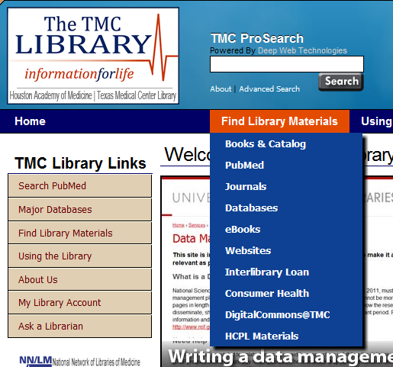
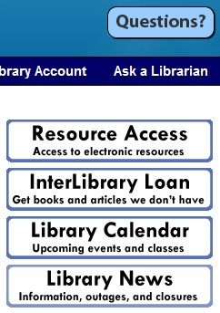
Find it online – www.library.tmc.edu
Collections
Journals/eJournals
eBooks
Databases
Interlibrary Loan
Items from other libraries
Reference
Ask questions
Get help
Contact a librarian
Interlibrary Loan
Resource Access
Sign up
Access online collections
Classes

Slide 13
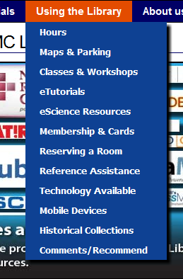
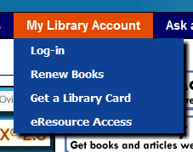
Find it online – www.library.tmc.edu
Selecting the Using the Library option on the Library’s homepage allows you to see a dropdown menu of library services, including:
Hours
Directions
Classes & Workshops
Historical Collections
Mobile devices & Apps
Selecting the My Library Account option allow you to login and renew books

Slide 14
Thank You!

