Slide 1
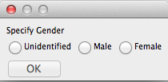
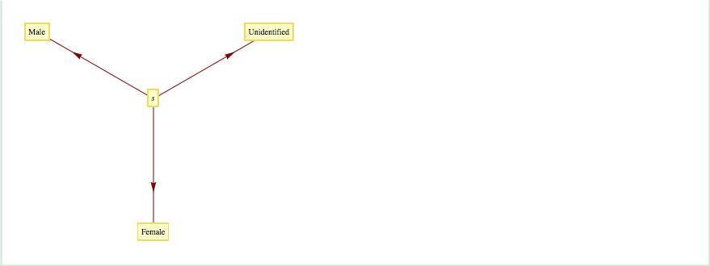
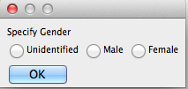
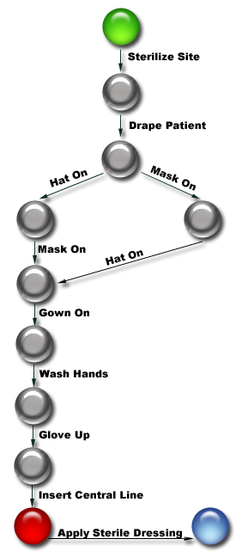
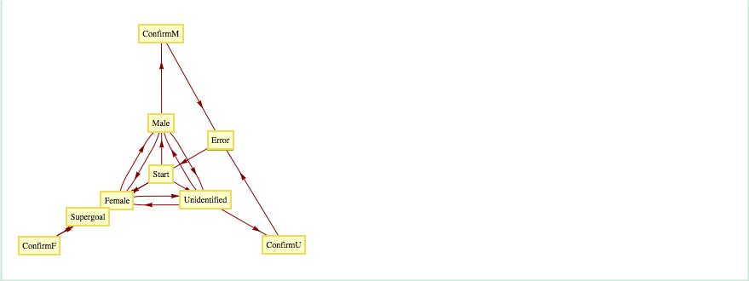
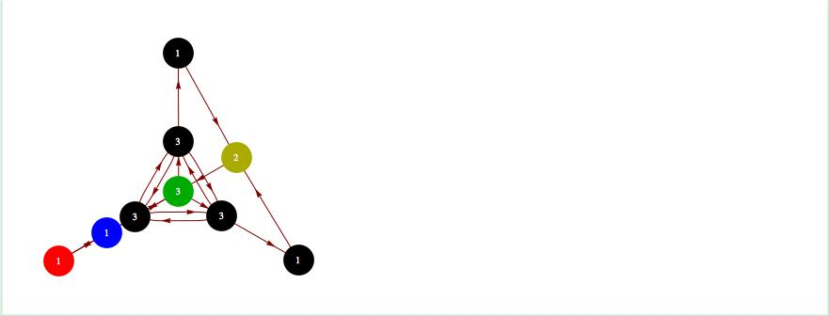
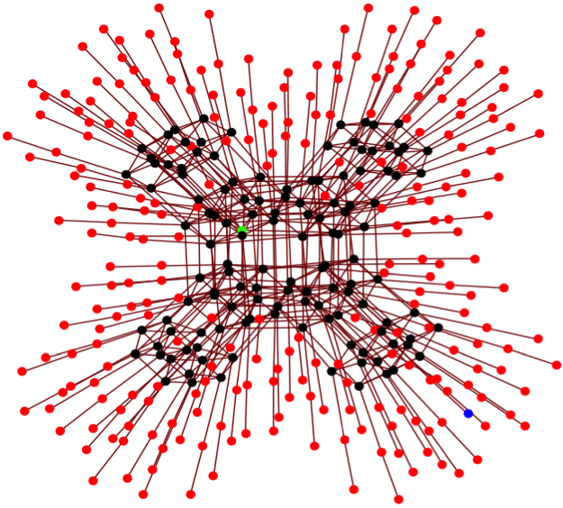

A Systematic Yet Flexible Systems Analysis Framework
Todd R. Johnson, PhD, Eliz Markowitz, MSa, Elmer V. Bernstam, MD, MS, Jorge R. Herskovic MD, PhD, Harold Thimbleby, PhD
The University of Kentucky Division of Biomedical Informatics
The University of Texas School Biomedical Informatics at Houston
MD Anderson Cancer Center
Swansea University
The Problem
SYF Systems Analysis (SYFSA)
The Task of Gender Selection
Interface 2: More Flexible, Allows Error Correction
Comparison of Idealized & System Spaces
Efforts to improve health care quality have led to an increased push to develop and adopt systems that enforce or encourage consistent procedures based on best practices and evidence-based medicine.
  Standard Operating Procedures
  Clinical Guidelines
  Decision Support Systems
  Hard Stops in EHRs
Although such systems can lead to more efficient and safer care, health care is filled with complexity, variations, and exceptions that are not easily captured by idealized processes.
Identify a task (a problem to be solved)
Analyze three problem spaces
  Idealized space: The best or idealized practice
  Natural space: Natural constraints on task performance
  System space: The new or redesigned system
Quantitatively compare flexibility measures for each space.
List the tasks the interface must support
  s → Male
  s → Female
  s → Unidentified
Each task requires 0 bits
Interface 1
Convert
Interface 2
Interface 3
Idealized: The best practice
System:
How the work is done in the (re)designed system
Natural: All possible practices in the real world
3.16 bits per task
Combine All Task Spaces to Create the Idealized Space
Interface 3: Too Flexible, User can exit without selection
What are Systematicity and Flexibility?
Convert
Systematicity
  Provides structure to ensure consistency, efficiency, and safety by imposing necessary structure
Flexibility
  The ability to constantly adapt to circumstances and still reach the goal state
Systematicity & Flexibility are at odds with one another.
Inserting a Central Line
Idealized
3.58 bits per task
Analyze task by converting the System Space to a Markov Model
Average bits per task :
Conclusion
Interface 1: Direct Implementation
Task graph
  Decrease system flexibility to prevent paths that are not in the idealized space.
  Increase system flexibility to allow error recovery from paths that do not align with the current goal.
Mean visits per Successful Task
Goals of a Systematic Yet Flexible (SYF) Framework
Ideal Space
System Implementation
  Guide the design of systems that support graceful degradation from idealized practices to those that are more suitable for a given situation
  Allow exploration of trade-offs among designs
  Provide an objective measure of flexibility for comparing designs
Natural
Acknowledgements
Convert
This project is supported by a training fellowship to E. Markowitz from the AHRQ Training Program of the W. M. Keck Center for Interdisciplinary Bioscience Training of the Gulf Coast Consortia (AHRQ Grant No. T32 HS017586) and by Grant No. 10510592 for Patient-Centered Cognitive Support under the Strategic Health IT Advanced Research Projects Program (SHARP) from the Office of the National Coordinator for Health Information Technology.
Convert
1 Success for every 2 Errors, so the Task Completion Rate is 1/3
Contact information
Todd.R.Johnson@uky.edu scholar.uky.edu/trjohnson/
Upon selection, dialog closes and selection is recorded— regardless of whether or not the selection is correct.

